Slide 1

Olist Marketing Analysis
Presented By – Mohit Negi
Notes:
A Data Driven Algorithmic Marketing system for brazil’s biggest online marketplace Olist, to segment customers, RFM & Uplift Modeling, Identify Upselling and Cross Selling opportunities using Targeted Recommendations.

Slide 2
Approach
EDA
Trend Analysis of Products and Customers
User Segmentation
RFM Modelling
Cohort Analysis
Marketing Actions
Notes:
1. I started with EDA and Trend Analysis of Products and Customers to get insights of the Business.
2. Segmented customers into specific clusters based on Cohort Analysis, RFM Modelling using their purchasing behaviour.

Slide 3
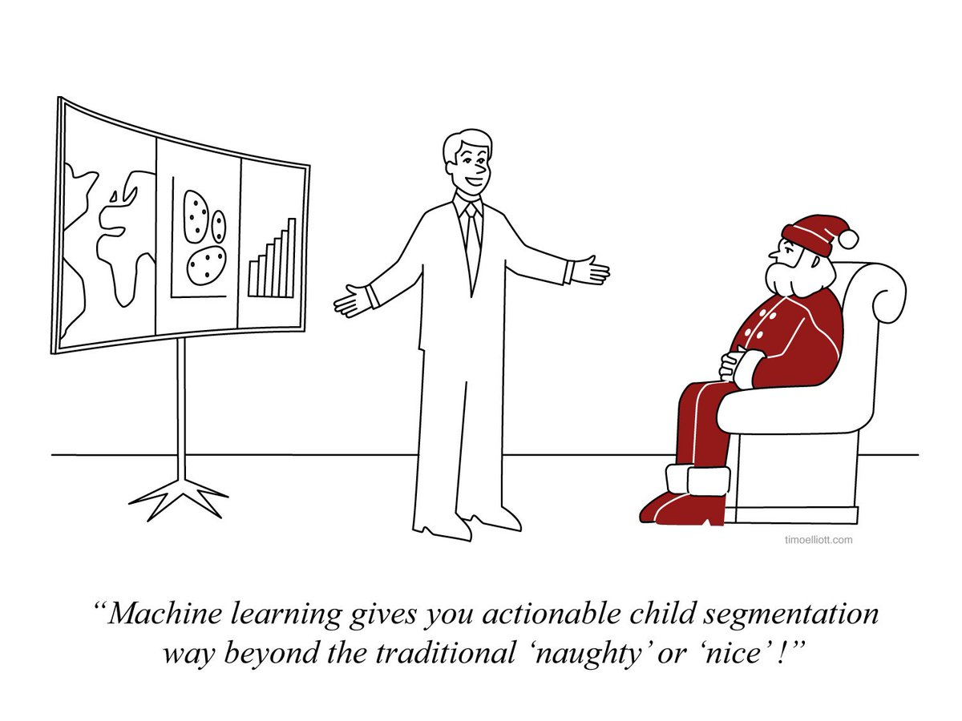
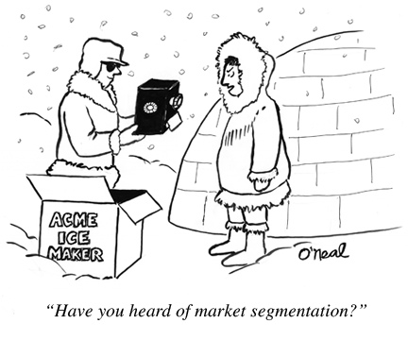
Why do we need to segment users?
Effective allocation of marketing resources.
Maximisation of cross and up-selling opportunities
Notes:
Marketing Analytics at Olist helps in measuring, managing and analyzing marketing performance to maximize its effectiveness and optimize ROI.
Understanding Marketing analytics allows Olist to minimize wasted web marketing dollars by attributing budget to the targeted campaign, missed opportunities by not being able to show recommendations personalized as per the user's preferences.

Slide 4
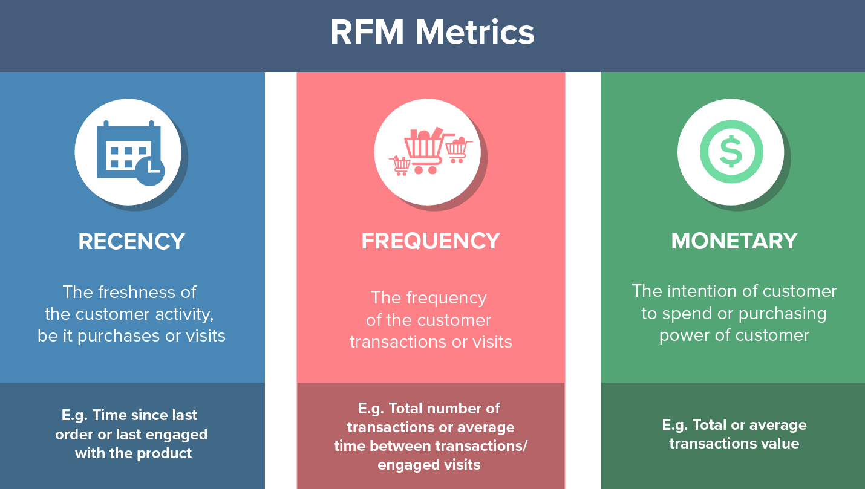
How to segment?
Segmentation using RFM Analysis
Cohort Based
Notes:
What is RFM Analysis?
RFM analysis is a data-driven customer behavior segmentation technique where RFM stands for recency, frequency, and monetary value.
The idea is to segment customers based on when their last purchase was(Recency),
How often they’ve purchased in the past(Frequency),
And how much they spent(Monetary).
All three of these measures have proven to be effective predictors of a customer’s willingness to engage in marketing messages and offers.
to shw of previous data

Slide 5
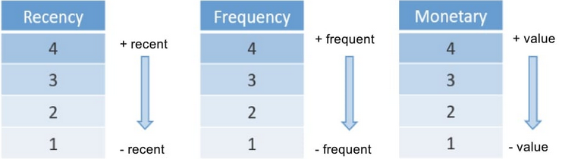
How does RFM scoring work?
Notes:
The highest values of each variable correspond to the most favorable segments,
so the more recent the sale, the higher the number in the recency segment;
the higher the sales frequency, the higher the number in the Frequency segment;
and the higher the value of
combinations ranging from 444 to 111
Although I chose 4 levels (with quartiles), it is quite common to work with 5 levels (quintiles) and 10 levels (deciles).sales, the higher the number in the Monetary segment.

Slide 6
How does RFM help Olist-Ecommerce?
Answer : We found NEW customer segments.

Slide 7

TINDER story of formation of new customer segments
Soulmates
Lovers
New Passion
Flirting
Potential Lovers
Platonic Friend
About to Dump You
Don Juan
Lovers
Apprentice
Break

Slide 8
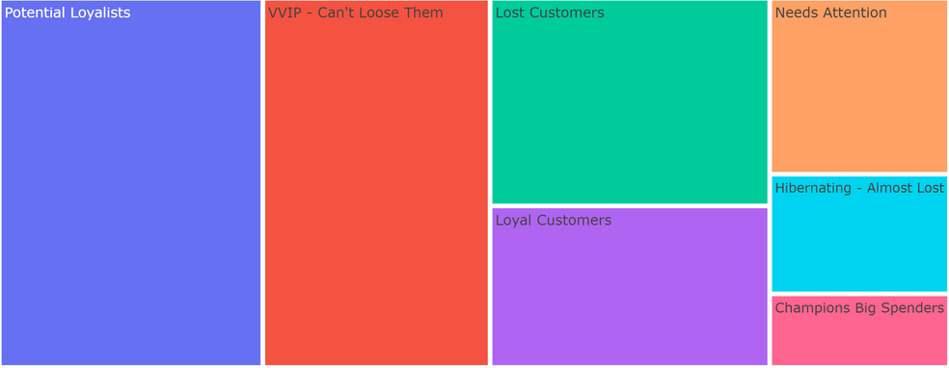
Action Plan for your New Tinder date?
Notes:
Using RFM anaylsis , I created the below Clusters or segments of customers to further give targeted recommendation to them.
Potential Loyalists — High potential to enter our loyal customer segments, why not throw in some freebies on their next purchase to show that you value them!
Needs Attention — Showing promising signs with quantity and value of their purchase but it has been a while since they last bought sometime from you. Let's target them with their wishlist items and a limited time offer discount.
Hibernating Almost Lost — Made some initial purchases but have not seen them since. Was it a bad customer experience? Or product-market fit? Let's spend some resources building our brand awareness with them.
Lost Customers — Poorest performers of our RFM model. They might have gone with our competitors for now and will require a different activation strategy to

Slide 9
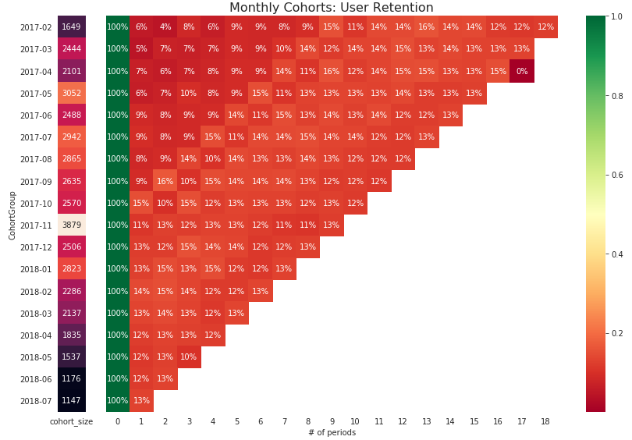
Cohort Retention

Slide 10
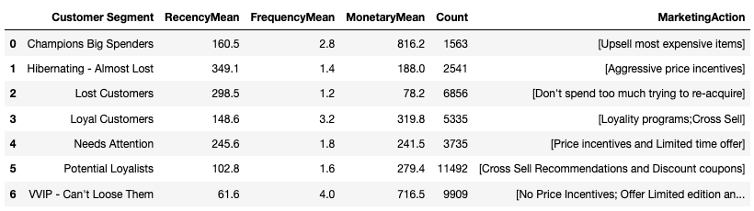
RFM
Notes:
(45%) of our customers are in the top tier RFM levels.
Olist must be doing something right to be maintaining their loyalty
The other 55% will need some work.

Slide 11
Hypothesis Results
HYPOTHESIS – Customers who are active users on OLIST are not the frequent/Buyers.

